Slide 1
Ethics & Innovation in an IT Start-Up
SPROUT
2020

Slide 2
CONTENT
Ethics for Business and Innovation
Advantages of Ethics for Entrepreneurs
How to Implement Ethics?
Code of Ethics
Establish the Code of Ethics
Managers and Entrepreneurs
Corporate Social Responsibility (CSR)
CSR Examples
Advantages of CSR
How can your company do CSR?
Ethics in Data Science
5 Principles of Ethics in Data Science (Examples)
ESG Investing and Technology
ESG Policies
Our Ethical Statement
Test Case
Notes:
ESG: Environmental, Social and Governance

Slide 3
ETHICS FOR BUSINESS AND INNOVATION
Ethics
Business Ethics
Ethics in Innovation
System of moral principles that affect how people make decisions and lead their lives.
Concerned with what is good for individuals and society
Appropriate business policies and practices regarding potentially controversial subjects including:
Corporate governance
Insider trading
Bribery
Discrimination
Corporate social responsibility
Provide new means for specific ends reflecting upon the consequences connected to them.
Consider aspects such as availability, inclusion and required knowledge and capabilities required to use them.
Notes:
Corporate governance is the system of rules, practices, and processes by which a firm is directed and controlled.
Firms have to think about the availability of their products especially if the cure from a fatal disease or social inclusion with respect to a new technology depend on them.

Slide 4
ADVANTAGES OF ETHICS FOR ENTREPRENEURS
1
Ethics can create an element of trust, familiarity and predictability in the business.
2
Customers are interested in dealing with firms that are ethical
3
Ethical decision making becomes a source of distinctiveness and competitive advantage.
4
Unethical companies get a bad reputation, pushing customers away.
Notes:
Customers are interested in dealing with firms that are ethical. Thus, ethical decision making becomes a source of distinctiveness and competitive advantage. This means that entrepreneurs can make their firms do more good and get ahead of competition just by doing so.

Slide 5


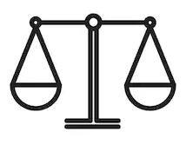

HOW TO IMPLEMENT ETHICS?
Best practices
Training programs
Company policies
Guidelines based on existing laws
Code of Ethics
Corporate Social Responsibility (CSR) programs

Slide 6

CODE OF ETHICS
Companies should place high priority on ethical behavior.
One way to address this is through a code of ethics.
Advantages:
Clearly states what represents ethical behavior.
Employees are more likely to ensure their behavior meets the expectations.
Makes a statement about the beliefs and values of the organization.
Notes:
Placing high priority on ethical behavior helps regulate scandals caused by questionable employee actions.
Not only companies have code of ethics, also schools/universities have student code of ethics

Slide 7

ESTABLISH THE CODE OF ETHICS
The code by itself is not enough to encourage ethical behavior.
Employees model their behavior from the organization’s leaders.
What is said / What is done
Managers must lead by example
Ethics should be one of the organization’s core values
Establish a safe environment.
Create a culture where employees feel safe to voice concerns about unethical behavior.
Managers should reinforce the code through words and actions based on the feedback received from employees.
Notes:
The code by itself is not enough to encourage ethical behavior, a system is necessary.
Since employees model their behavior based on the leaders, the leaders must make sure they act ethically. Managers specially must abide by the code of ethics. Employees quickly tell the difference between what is said and what is done. Leaders should “walk the talk”.
Ethics should be one of the organization’s core values (part of their identity and reflected in the culture).
Ethics is reflected in hiring practices. Candidates who display honesty and integrity impress the managers. Source: Max Messmer, “Does Your Company Have a Code of Ethics?” Strategic Finance, April 2003.
If employees voice their concerns, managers can fix the issues. Taking action is important because it reinforces the code of ethics.

Slide 8
MANAGERS AND ENTREPRENEURS
MANAGERS
ENTREPRENEURS
Need to forgo their personal values for those of the organization
Create their organizations such that its values are aligned to their own.
Less likely to view the organization as their own
Sense of ownership leads to fair treatment of resources
Employees follow leader’s decisions
Stronger relationships with customers leads to more ethical behavior towards them.
Notes:
Largely similar in ethical decision making, but some important differences to consider:
Managers face the issue of needing to forgo their personal values for those of the organization. Entrepreneurs can create their organizations such that its values are aligned to their own.
Managers are less likely to view the organization as their own, thus treating it less fairly than an entrepreneur treats its own firm.
As managers and entrepreneurs develop stronger relationships with customers and stakeholders, the more likely it is that they will be more ethical towards them and the communities they might represent.

Slide 9
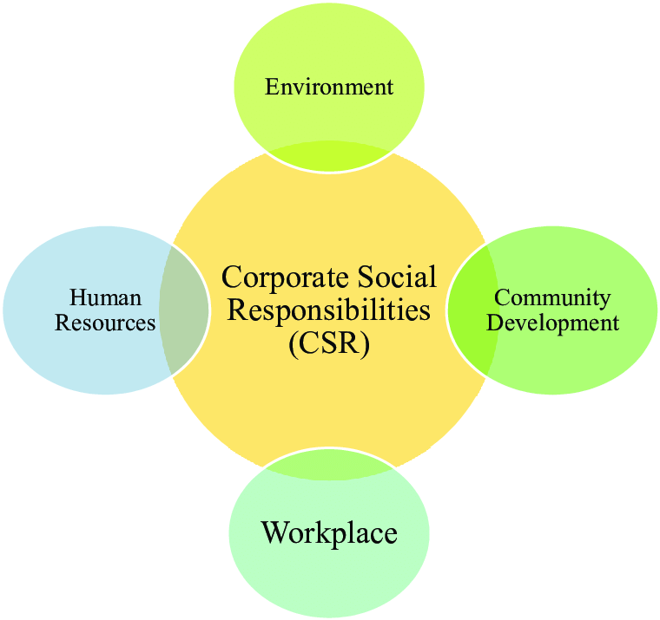
Corporate Social Responsibility (CSR)

Slide 10





CSR Examples
Hiring refugees/veterans
52 weeks of paid parental leave
Sustainably sourced lego pieces
Data centers use 50% less energy
Donated 260 million to nonprofit and educational institutions

Slide 11
Advantage of CSR
Positive image of the company (Branding)
92 percent of consumers have a more positive image of companies that support social issues and environmental efforts
Increase in sales
87 percent will purchase a product because a company advocated for an issue they cared about
Attracts top talents
Millennials expect companies to care about social issues and will reward those that partner with the right causes (Boston Consulting Group, 2012)

Slide 12
How can your company do CSR?
Align your efforts with your brand
Focus your attention
Don’t overlook local initiatives
Involve your customers
Advertise charitable efforts

Slide 13

ETHICS IN DATA SCIENCE
Data Privacy
Our data shouldn’t be exposed
Avoid Unfair Bias
5 principles of ethics in Data Science
Data Sharing
ACM code of ethics
“foster an ethical behavior in anyone who uses technology in an impactful way”
AI shouldn’t promote discrimination
Our data shouldn’t be accessed by third parties
Human Will
Transparency
Our data shouldn’t be used against ourselves
For which purposes our data is actually being used
Notes:
https://towardsdatascience.com/5-principles-for-big-data-ethics-b5df1d105cd3
https://www.acm.org/code-of-ethics
Treat violations of the Code as inconsistent with membership in the ACM.

Slide 14


APPLY ETHICS IN DATA ORIENTED BUSINESSES
Data Privacy
1. Train your employees.
2. Secure sensitive information.
3. Properly dispose of sensitive data.
4. Use strong password protection.
5. Protect against malware.
6. Control physical access to your computers.
7. Encrypt data.
8. Keep your software and operating systems up to date.
9. Secure access to your network.
10. Verify the security controls of third parties.
Over 500,000 Zoom accounts sold on hacker forums
Notes:
https://www.bleepingcomputer.com/news/security/over-500-000-zoom-accounts-sold-on-hacker-forums-the-dark-web/

Slide 15
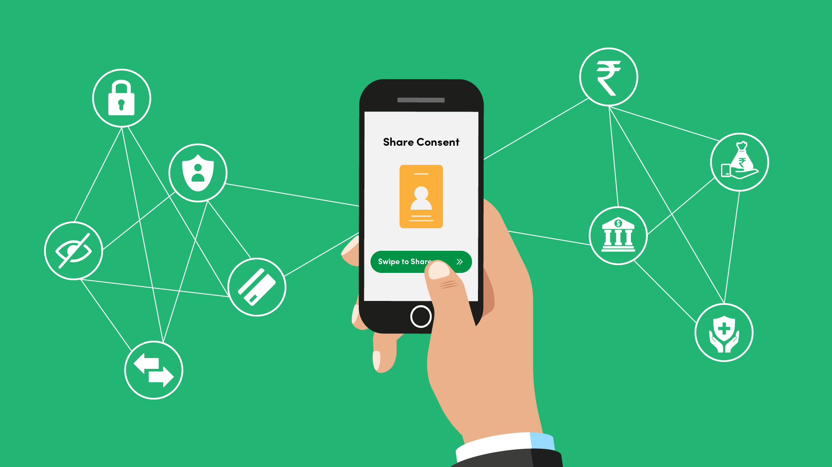

APPLY ETHICS IN DATA ORIENTED BUSINESSES
Data Sharing
Get consent to retain and share data
Be thoughtful when considering risks of re-identification
De-identification
Facebook Data shared to third parties
Notes:
you must seek their informed consent by means of a procedure that meets the minimum standards of the GDPR, if the data processing entails potential risks to the data subjects’ rights and freedoms, they must be made aware of these risks during the informed consent procedure.
Some data, although not easily re-identifiable by the public, are easily re-identifiable by people who know the participant. In some cases, that may be acceptable; in others, it may cause considerable harm
Generally, a dataset is said to be de-identified if elements that might immediately identify a person or organisation have been removed or masked.
Unfortunately, there exist no robust, unanimously internationally agreed definitions for the terms de-identification, anonymisation, and pseudonymisation.

Slide 16

APPLY ETHICS IN DATA ORIENTED BUSINESSES
Transparency: Asking for consent to process the data should include:
1. The identity of the data controller
2. The specific purpose(s) of the processing for which the
personal data will be used;
3. The subject’s rights as guaranteed by the GDPR and the EU Charter of Fundamental Rights,
4. Information as to whether data will be shared with or transferred to third parties and for what purposes
5. How long the data will be retained before they are destroyed
France fines Google $57 million over data transparency
Notes:
3. in particular the right to withdraw the consent or access their data, the procedures to follow if they wish to do so
EX: France's CNIL regulator has fined Google $57 million for allegedly failing to provide transparent, "easily accessible" data consent policies.

Slide 17

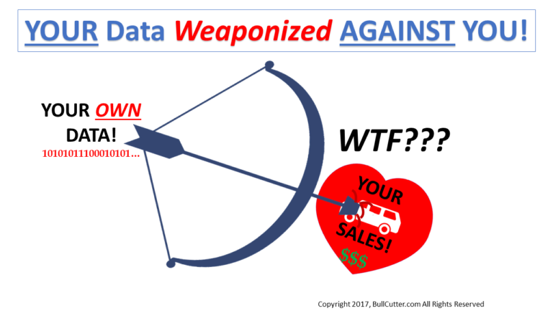
APPLY ETHICS IN DATA ORIENTED BUSINESSES
Human Will
1. Focus on data transparency
2. No data sharing without consent
3. Keep data safe from being leaked
In 2014, activity data from a fitness tracker was used as evidence in a personal injury lawsuit for the first time
Notes:
The data shouldn’t be used against the customers. In order to do this, your company should
2. Some data, although not easily re-identifiable by the public, are easily re-identifiable by people who know the participant. In some cases, that may be acceptable; in others, it may cause considerable harm
3. illegally access from outside and even inside the company
Ex:as an objective measure of activity.
A Canadian law firm used data from a Fitbit fitness tracker for the first time in court

Slide 18
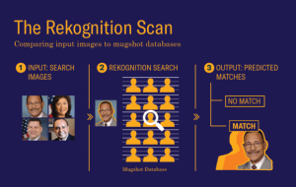

APPLY ETHICS IN DATA ORIENTED BUSINESSES
Bias and Discrimination
1. Pre-processing the data
2. Reinforce transparency in data mining by using interpretable algorithms
3. Limit or deny the disclosure of sensitive data in specific contexts
4. Educate data scientists in building proper models
Nearly 40% of Amazon Rekognition’s false matches in the test were of people of color
Notes:
that involve the sanitization or distortion of the training data set to remove possible bias in order to prevent the new model from learning discriminatory behaviors
that will give explanations on the logical steps behind a certain classification
(e.g. health data in employment) or even deny specific uses of data in contexts where sensitive data is already disclosed if such use might cause harm to the individual
such as the creation of a knowledge base platform for fairness in data mining that could be investigated by data scientists in case they stumbled upon prob- lematic correlations
EX: A study form The American Civil Liberties Union (ACLU) shows that an Amazon’s AI-based facial recognition software called “Rekognition” falsely matched 28 US Congress members with a database of criminals. According to the study, “Nearly 40 percent of Rekognition’s false matches in their test were of people of color

Slide 19
ESG Investing and technology
ESG stands for Environmental, Social and Governance.
Environmental factors:
Air and water pollution
Waste management
Deforestation
Climate change
Energy efficiency
Social factors:
Labour standards
Customer satisfaction
Human rights
Data protection and privacy
Employee management
Governance factors:
Bribery and corruption
Board composition
Executive compensation
Audit committee
Lobbying
“Adopting environmental and social policies can destroy shareholder wealth”
Galaskiewicz, 1997

Slide 20
ESG policies
Are a reflection of an organization with a culture of sustainability. Companies with a culture of sustainability face tighter constraints.
“Culture consists on a specific collection of values and norms that are shared by people and groups in an organization and that control the way they interact with each other and with stakeholders outside the organization”
Hills and Jones (2001)

Slide 21
High sustainability companies
Advantages:
attracts better human capital
establishes more reliable supply chains
high levels of transparency
refuses to pay bribes and become part of corruption
proactively reduces environmental externalities
avoids conflicts with nearby communities
more successful in B2C sector
passing on valuable investment opportunities that do not fit their values
lower earning margins
higher product prices influence on losing customers

Slide 22
.
“A single company that’s not careful, and breaks the trust of its users, can cause a domino effect in which consumers lose trust in the greater technology and any company leveraging it. Enterprises need to develop internal principles and processes that hold people, from the board to the newest hire, accountable. These frameworks should govern corporate practices and transparently showcase companies’ commitment to ethical AI and data practices.”
Klaus-Michael Vogelberg

Slide 23
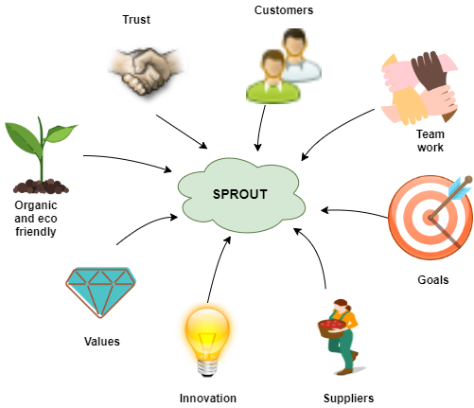

SPROUT’S ETHICAL STATEMENT
Transparency, integrity, responsibility and generosity will be the core values of all our business deals because we seek greatness. We expect nothing less from our suppliers because our purpose is to serve best our most important stakeholders, the customers. For us, the key to success is a relationship built on, respect, honesty and fairness and for this, we ensure to perform our duties to the highest ethical standards.

Slide 24
THANK YOU!

Slide 25
EXERCISE FOR CLASS
Apple vs. FBI Case Study
In a terrorist attack in San Bernardino (2015), attention turned to the perpetrator’s iPhone.
A federal judge asked Apple to provide “reasonable technical assistance” to the FBI in accessing the information on the phone with that hope of discovering additional threats to national security.
Apple CEO Tim Cook refused to cooperate. Cook advocated for the benefits of encryption in society to keep personal information safe.
Q1: Was Apple wrong for not complying with the FBI’s request? If so, why? If not, why not?
Q2: What are the code of ethics and the ethical implications in your startup company?
Notes:
Prepare a quiz or a meaningful exercise that the teams will do in 15 minutes, perhaps related to their own start-up, before we go back to the plenary and that uses some of the content that you shared during your presentation. The exercise and questions to address have to be very clear.
https://www.scu.edu/ethics/focus-areas/business-ethics/resources/apple-vs-fbi-case-study/
https://www.scu.edu/ethics/privacy/case-study-on-online-privacy /

Slide 26
REFERENCES
Hisrich, R., et al. Entrepreneurship. 10th Edition. McGraw-Hill Education. (2017)
AN ORGANIZATION’S CODE OF ETHICS (Page 21)
DO ENTREPRENEURS AND MANAGERS DIFFER IN ETHICAL CONDUCT? (Page 40)
DO THE RIGHT THING (Page 70)
(2014) Ethics: a general introduction. BBC. Retrieved from http://www.bbc.co.uk/ethics/introduction/intro_1.shtml
Twin, E. (Jan. 2016). Business Ethics. Investopedia. Retrieved from https://www.investopedia.com/terms/b/business-ethics.asp
Hanekamp, G. (2007) Business Ethics of Innovation. Springer, Berlin, Heidelberg.
Eccles, R., Ioannou, I., Serafeim, G. (2014). The Impact of Corporate Sustainability on Organizational Processes and Performance.

